Slide 1
Mechanism and Effect Size in Human-Microbiome Association Studies
Anthony Fodor
Bioinformatics and Genomics
UNC Charlotte

Slide 2
Assertion:
Human Metagenome Association Studies have
(sometime vanishingly small) effect sizes
Like GWAS studies, human metagenome association
studies can require large sample sizes

Slide 3
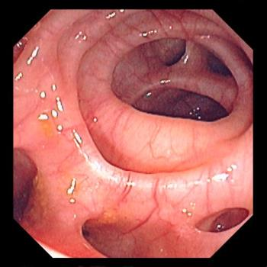


Roshonda Barner Jones
University of Southern California
Biopsies from 226 case and 309 control obtained via
colonoscopy
Temitope Keku
UNC Chapel Hill
Image: https://www.merckmanuals.com/-/media/manual/professional/images/diverticulosis_high.jpg?la=en&thn=0&mw=350
An Aberrant Microbiota is not Strongly Associated with Incidental Colonic Diverticulosis Roshonda B. Jones, Anthony A. Fodor, Anne F. Peery, Matthew C. B. Tsilimigras, Kathryn Winglee, Amber McCoy,Michael Sioda ,Robert S. Sandler, Temitope O. Keku. Scientific Reports. 2018.
Notes:
A colonic diverticulum is a saclike pouch of colonic mucosa and submucosa that protrudes through the muscular layer of the colon

Slide 4
Roshonda Barner Jones
University of Southern California
Biopsies from 226 case and 309 control obtained via
colonoscopy
Temitope Keku
UNC Chapel Hill
Microbial DNA extracted – PCR targeting the 16S rRNA gene
Image: https://www.merckmanuals.com/-/media/manual/professional/images/diverticulosis_high.jpg?la=en&thn=0&mw=350
An Aberrant Microbiota is not Strongly Associated with Incidental Colonic Diverticulosis Roshonda B. Jones, Anthony A. Fodor, Anne F. Peery, Matthew C. B. Tsilimigras, Kathryn Winglee, Amber McCoy,Michael Sioda ,Robert S. Sandler, Temitope O. Keku. Scientific Reports. 2018.
Notes:
A colonic diverticulum is a saclike pouch of colonic mucosa and submucosa that protrudes through the muscular layer of the colon

Slide 5
Roshonda Barner Jones
University of Southern California
Biopsies from 226 case and 309 control obtained via
colonoscopy
Temitope Keku
UNC Chapel Hill
Microbial DNA extracted – PCR targeting the 16S rRNA gene
Sequences generated via Illumina sequencing.
Classified into a counts table
Image: https://www.merckmanuals.com/-/media/manual/professional/images/diverticulosis_high.jpg?la=en&thn=0&mw=350
An Aberrant Microbiota is not Strongly Associated with Incidental Colonic Diverticulosis Roshonda B. Jones, Anthony A. Fodor, Anne F. Peery, Matthew C. B. Tsilimigras, Kathryn Winglee, Amber McCoy,Michael Sioda ,Robert S. Sandler, Temitope O. Keku. Scientific Reports. 2018.
Notes:
A colonic diverticulum is a saclike pouch of colonic mucosa and submucosa that protrudes through the muscular layer of the colon

Slide 6
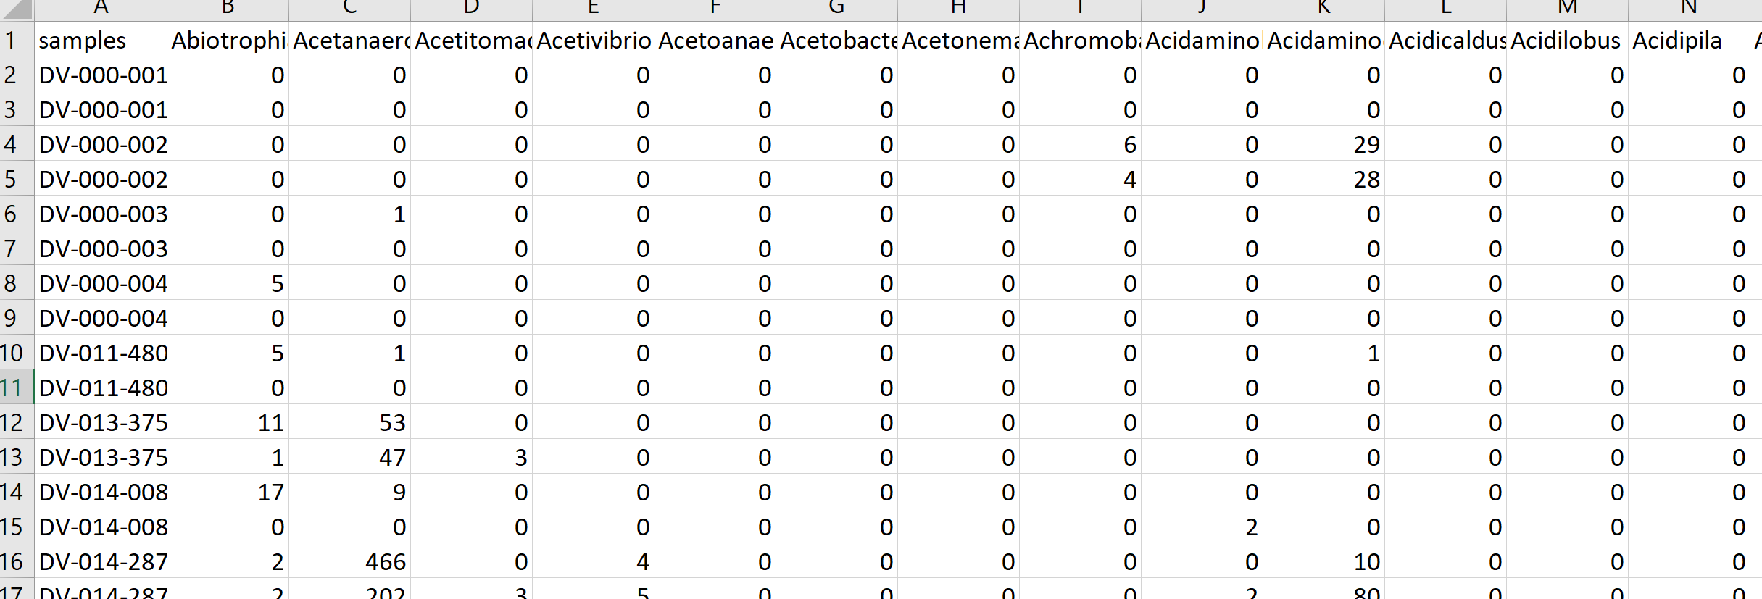
Roshonda Barner Jones
University of Southern California
Biopsies from 226 case and 309 control obtained via
colonoscopy
Temitope Keku
UNC Chapel Hill
Microbial DNA extracted – PCR targeting the 16S rRNA gene
Sequences generated via Illumina sequencing.
Classified into a counts table
Image: https://www.merckmanuals.com/-/media/manual/professional/images/diverticulosis_high.jpg?la=en&thn=0&mw=350
An Aberrant Microbiota is not Strongly Associated with Incidental Colonic Diverticulosis Roshonda B. Jones, Anthony A. Fodor, Anne F. Peery, Matthew C. B. Tsilimigras, Kathryn Winglee, Amber McCoy,Michael Sioda ,Robert S. Sandler, Temitope O. Keku. Scientific Reports. 2018.
Notes:
A colonic diverticulum is a saclike pouch of colonic mucosa and submucosa that protrudes through the muscular layer of the colon

Slide 7
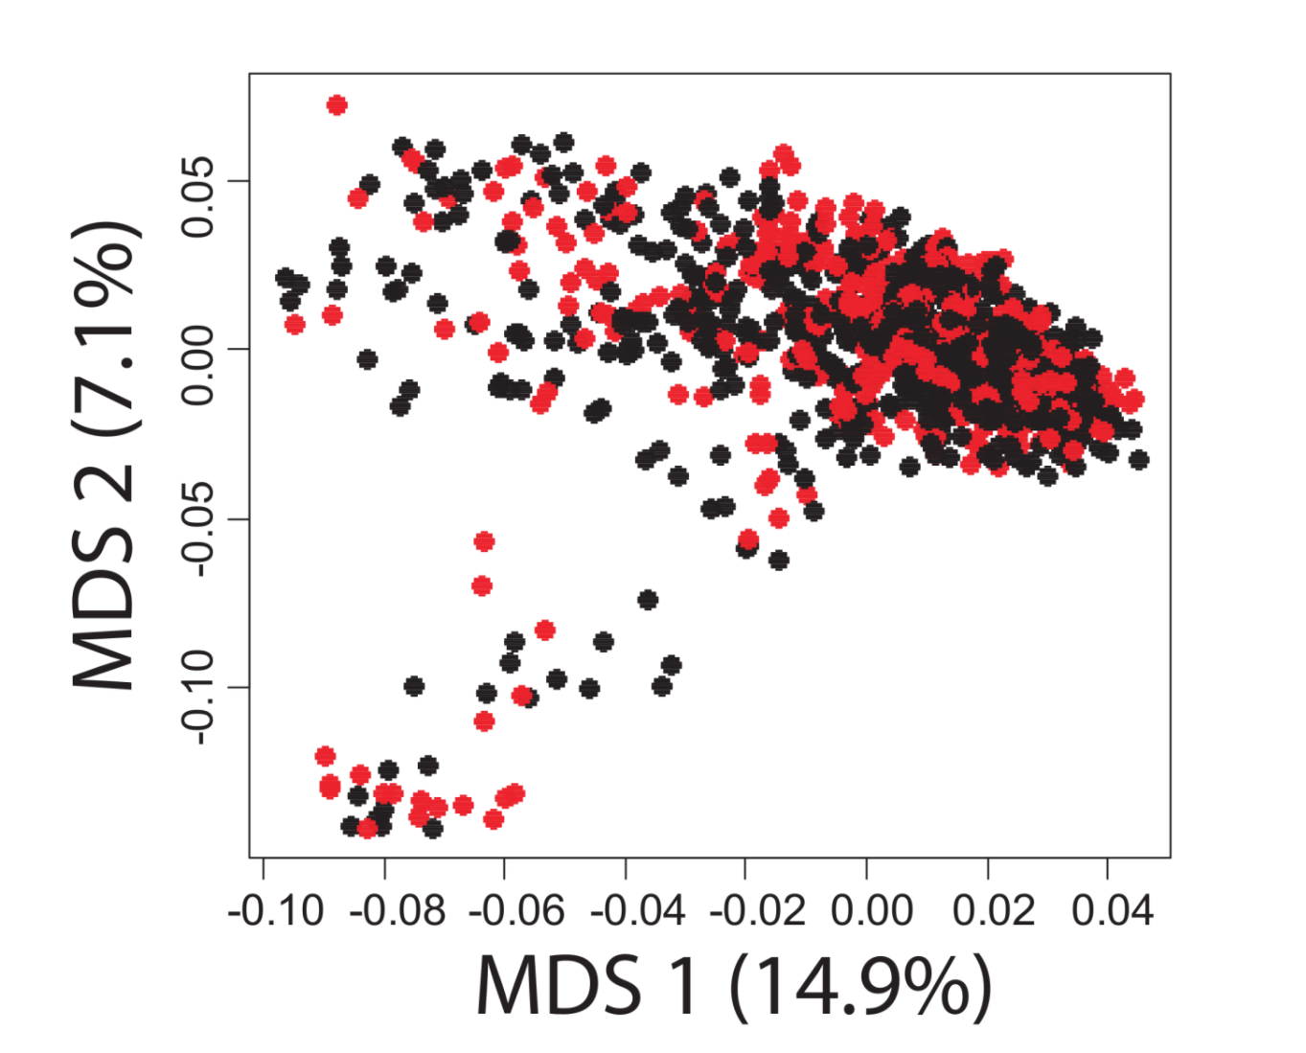
A case-control study in Colonic Diverticulosis with a small effect size
Roshonda Barner Jones
University of Southern California
Temitope Keku
UNC Chapel Hill
An Aberrant Microbiota is not Strongly Associated with Incidental Colonic Diverticulosis Roshonda B. Jones, Anthony A. Fodor, Anne F. Peery, Matthew C. B. Tsilimigras, Kathryn Winglee, Amber McCoy,Michael Sioda ,Robert S. Sandler, Temitope O. Keku. Scientific Reports. 2018.

Slide 8
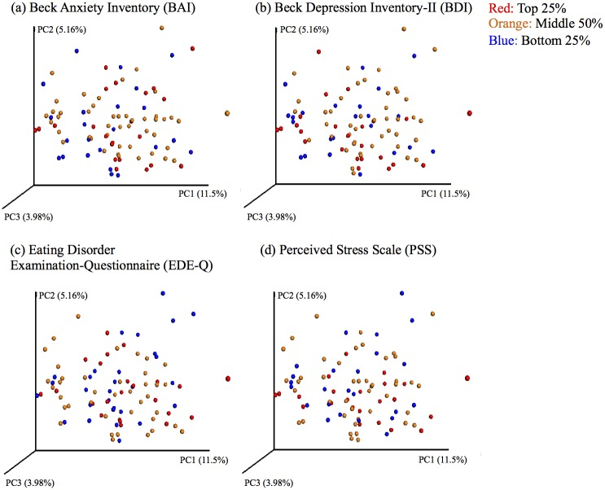

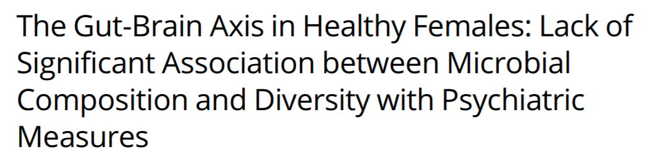
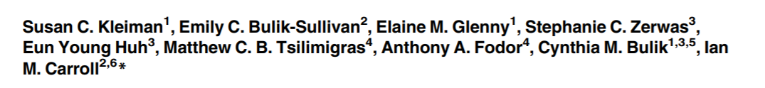
Ian Carroll
UNC Chapel Hill

Slide 9

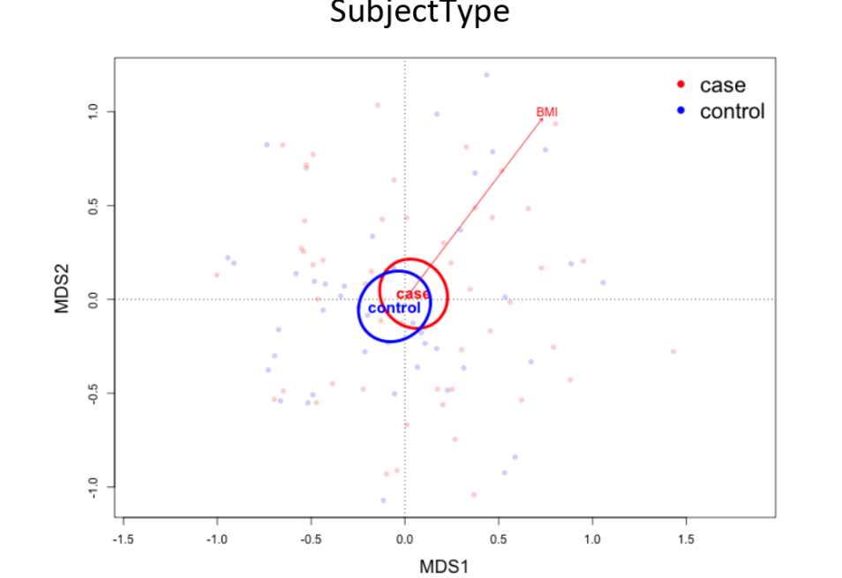

Metabolic Osteoarthritis
Richard F. Loeser UNC
Liubov Arbeeva UNC

Slide 10
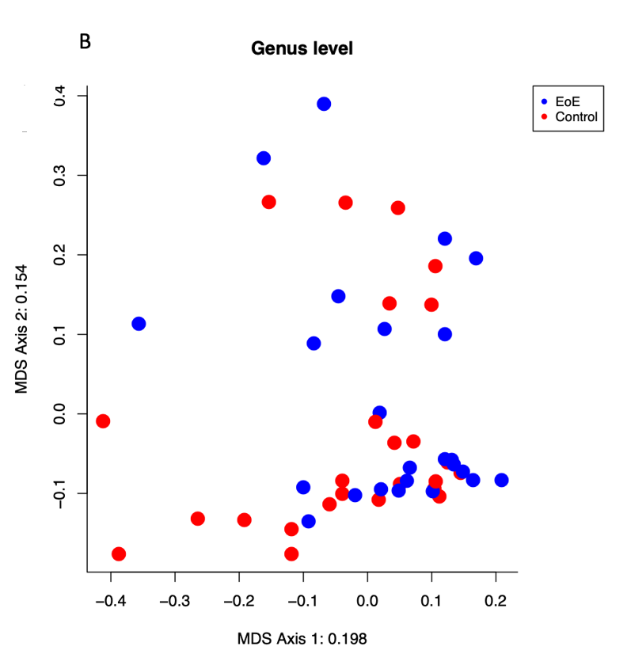


Eosinophilic esophagitis (EoE)
Evan Dellon, UNC
James Johnson, UNCC
Lack of association of the esophageal microbiome in adults with eosinophilic esophagitis compared with non-EoE controls. In preparation

Slide 11


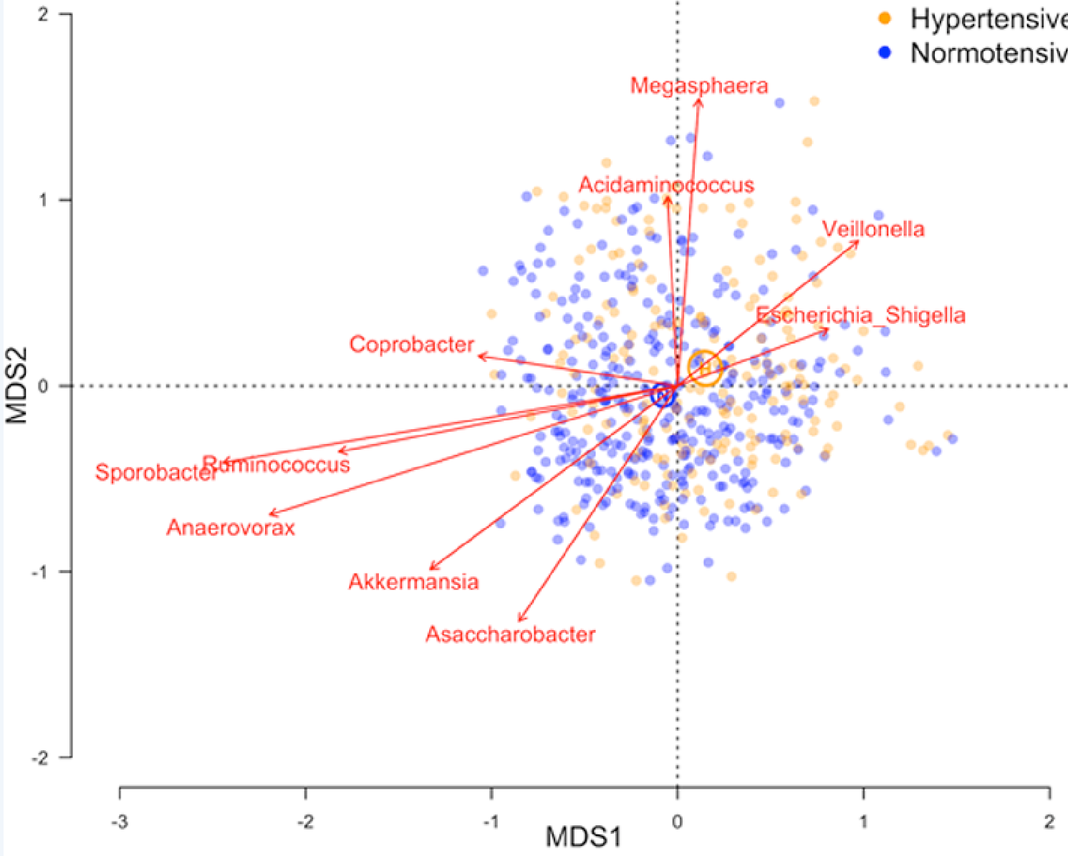


Shan Sun
UNC Charlotte
Katie Meyer UNC
N=529

Slide 12
Assertion: The microbiome is an environmental variable
and important interactions with the host are not
necessarily globally conserved

Slide 13
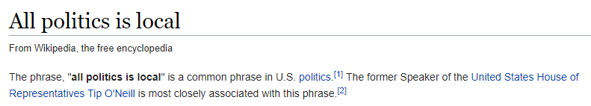


Slide 14

The microbiome is an environmental variable that is sensitive to local conditions
Penny Gordon-
Larsen
UNC Chapel Hill
Shan Sun
UNC Charlotte
In revision: Does geographical variation confound the relationship between host factors and the human gut microbiota: a population-based study in China. BMJ Open

Slide 15
The microbiome is an environmental variable that is sensitive to local conditions
2,164 subjects from the China Health and Nutrition Survey
(http://www.cpc.unc.edu/projects/china )
Penny Gordon-
Larsen
UNC Chapel Hill
Shan Sun
UNC Charlotte
In revision: Does geographical variation confound the relationship between host factors and the human gut microbiota: a population-based study in China. BMJ Open

Slide 16
The microbiome is an environmental variable that is sensitive to local conditions
2,164 subjects from the China Health and Nutrition Survey
(http://www.cpc.unc.edu/projects/china )
Fecal samples collected; 16S rRNA sequencing
Penny Gordon-
Larsen
UNC Chapel Hill
Shan Sun
UNC Charlotte
In revision: Does geographical variation confound the relationship between host factors and the human gut microbiota: a population-based study in China. BMJ Open

Slide 17
The microbiome is an environmental variable that is sensitive to local conditions
2,164 subjects from the China Health and Nutrition Survey
(http://www.cpc.unc.edu/projects/china )
Fecal samples collected; 16S rRNA sequencing
Classification and generation of count table
Penny Gordon-
Larsen
UNC Chapel Hill
Shan Sun
UNC Charlotte
In revision: Does geographical variation confound the relationship between host factors and the human gut microbiota: a population-based study in China. BMJ Open

Slide 18
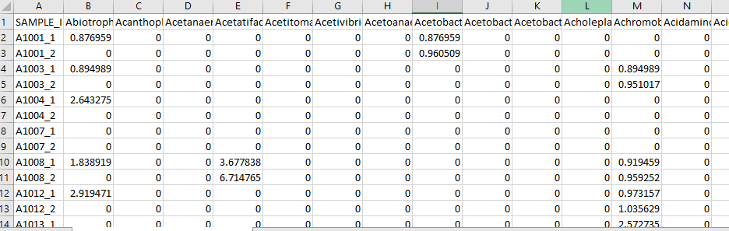
The microbiome is an environmental variable that is sensitive to local conditions
2,164 subjects from the China Health and Nutrition Survey
(http://www.cpc.unc.edu/projects/china )
Fecal samples collected; 16S rRNA sequencing
Classification and generation of count table
Penny Gordon-
Larsen
UNC Chapel Hill
Shan Sun
UNC Charlotte
In revision: Does geographical variation confound the relationship between host factors and the human gut microbiota: a population-based study in China. BMJ Open

Slide 19
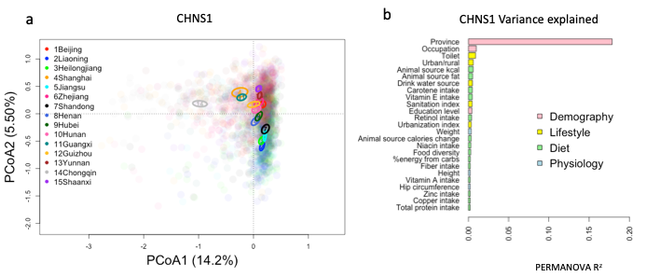
The microbiome is an environmental variable that is sensitive to local conditions
CHINA
Penny Gordon-
Larsen
UNC Chapel Hill
Shan Sun
UNC Charlotte
In revision: Does geographical variation confound the relationship between host factors and the human gut microbiota: a population-based study in China. BMJ Open

Slide 20
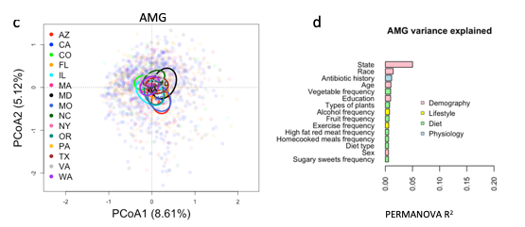
The microbiome is an environmental variable that is sensitive to local conditions
CHINA
Penny Gordon-
Larsen
UNC Chapel Hill
US
(American Gut)
Shan Sun
UNC Charlotte
(in preparation)
In revision: Does geographical variation confound the relationship between host factors and the human gut microbiota: a population-based study in China. BMJ Open

Slide 21
The microbiome is an environmental variable that is sensitive to local conditions
2,164 subjects from the China Health and Nutrition Survey
(http://www.cpc.unc.edu/projects/china )
Fecal samples collected; 16S rRNA sequencing
Classification and generation of count table
Penny Gordon-
Larsen
UNC Chapel Hill
Use the microbiome to predict subject phenotype
Shan Sun
UNC Charlotte
In revision: Does geographical variation confound the relationship between host factors and the human gut microbiota: a population-based study in China. BMJ Open

Slide 22
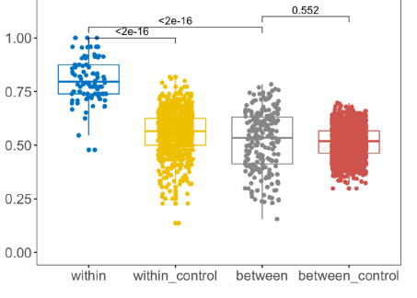
Machine learning models can be trained within but not across provinces
True Positive Rate
Penny Gordon-
Larsen
UNC Chapel Hill
Urban/Rural classification
Shan Sun
UNC Charlotte
In revision: Does geographical variation confound the relationship between host factors and the human gut microbiota: a population-based study in China. BMJ Open

Slide 23
Assertion:
Batch effects can be pronounced,
but this is not necessarily fatal to analysis

Slide 24
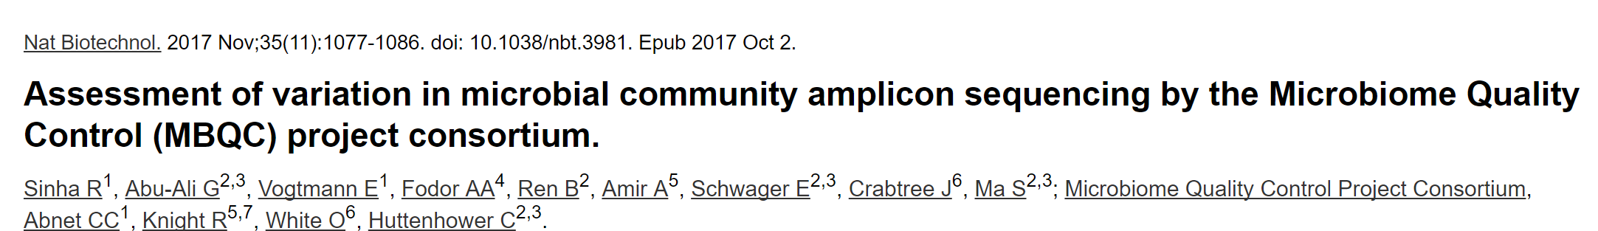


Lab to lab variation in protocols (especially microbial DNA extraction) can have
a profound impact…
Rashmi Sinha
NIH
Curtis Huttenower
Harvard

Slide 25
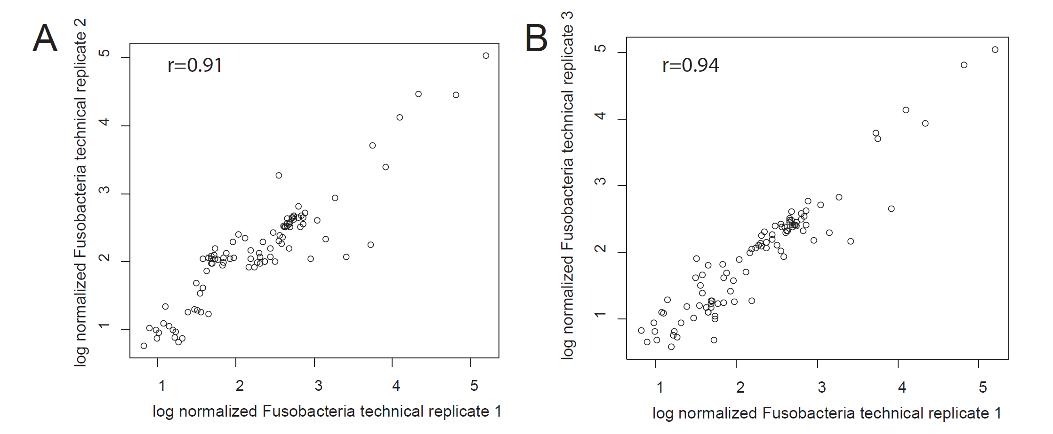
Within a pipeline, PCR and extraction steps can be highly replicable
Rifaximin Treatment is Associated With Small, Transient Decreases in Multiple Taxa in the Human Gut Microbial Community. Fodor et al. Gut Microbes. 2019

Slide 26
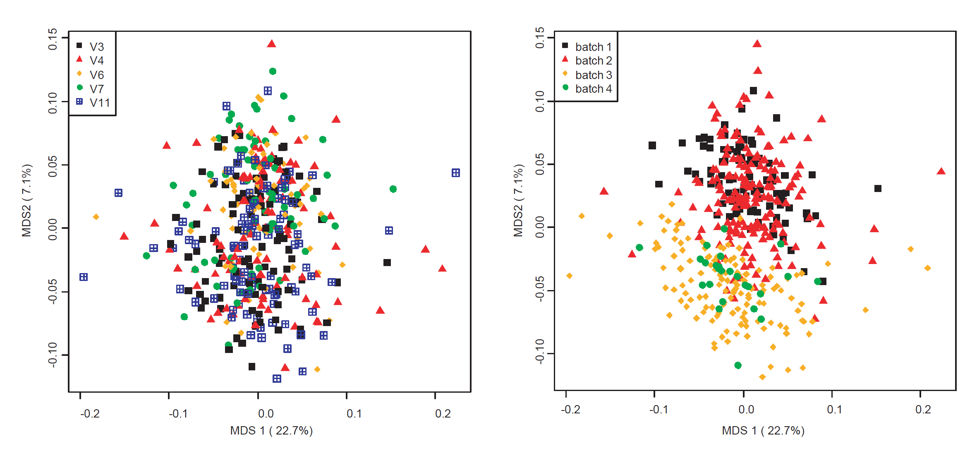
Batch effects can be pronounced
Batches are “islands”
Rifaximin Treatment is Associated With Small, Transient Decreases in Multiple Taxa in the Human Gut Microbial Community. Fodor et al. Gut Microbes. 2019

Slide 27
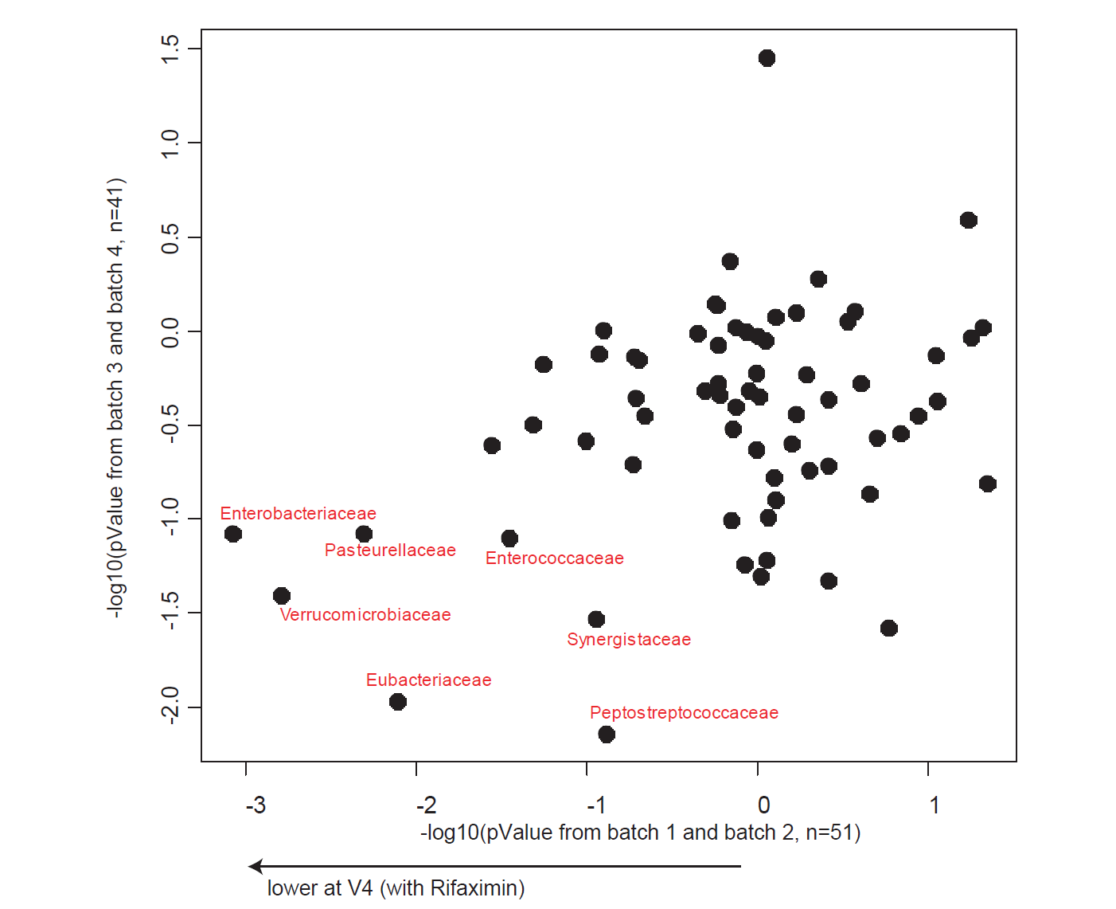
Inference can (hopefully) survive across batch effects
Rifaximin Treatment is Associated With Small, Transient Decreases in Multiple Taxa in the Human Gut Microbial Community. Fodor et al. Gut Microbes. 2019

Slide 28
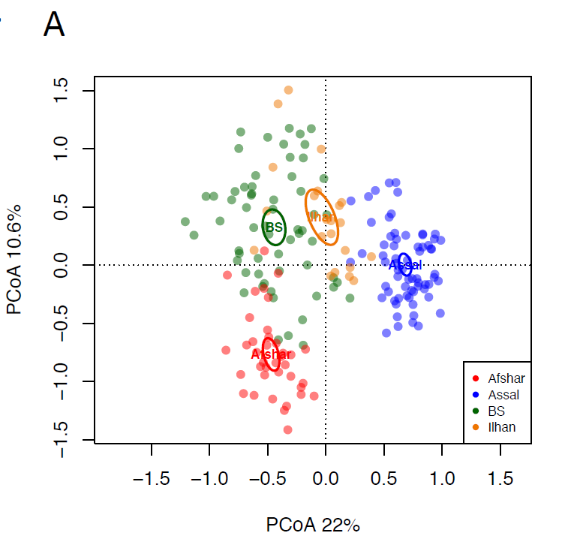


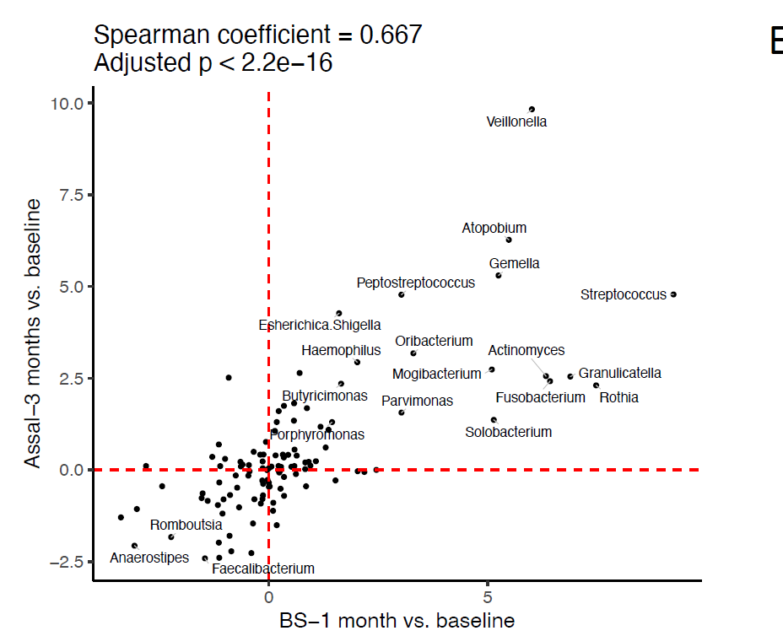

It is possible to get reproducible results across studies from different labs
Farnaz Fouladi
UNC Charlotte
Kristine Steffen
NDSU
Leslie Heinberg
Cleveland Clinic

Slide 29
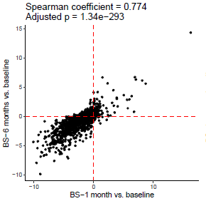
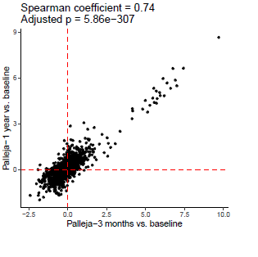
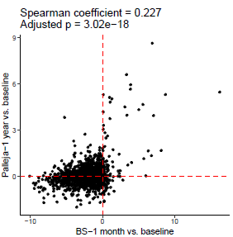
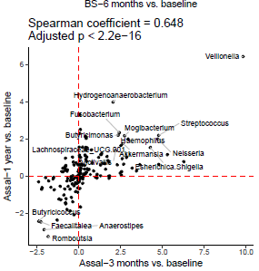
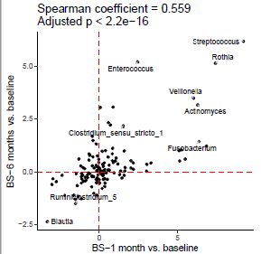
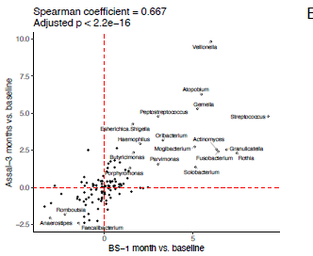
Reproducibly across batches can be observed at the pathway level
WGS
(humann)
16S
(genus)

Slide 30
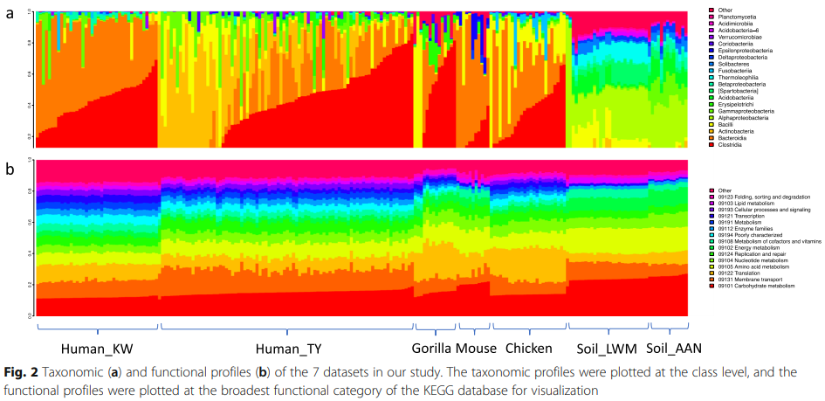
Inference-based accuracy of metagenome prediction tools varies across sample types and functional categories
Shan Sun, Roshonda B Jones, Anthony A Fodor. microbiome, 2020

Slide 31
Assertion:
Metagenome shotgun sequences “predicted” from 16S should be used with extreme caution.

Slide 32
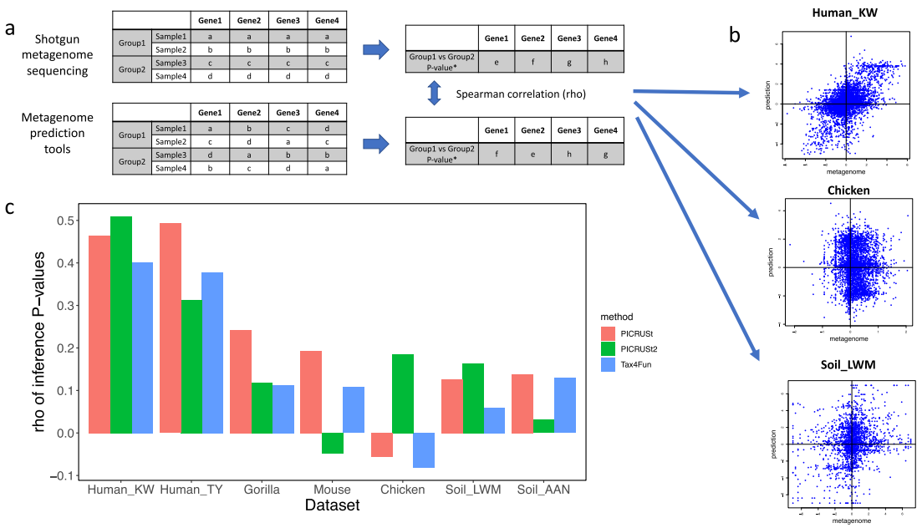
Inference-based accuracy of metagenome prediction tools varies across sample types and functional categories
Shan Sun, Roshonda B Jones, Anthony A Fodor. microbiome, 2020
Notes:
Each dataset has publicly available 16S rRNA and metagenome sequences and is associated with a two-level categorical metadata. The Human_KW study compared urban and rural subjects in China, while the US and non-US subjects were compared for the Human_TY study. In the gorilla study, the dry and wet seasons were compared while the mouse study compared community composition of two enterotypes. Lean and fat broiler chicken lines were compared for the chicken study. For the Soil_LWM study, Amazon dark earth and agricultural soil were compared, while forested and deforested soils were compared for the Soil_AAN study

Slide 33
Assertion: Drugs and surgery represent a more robust and reproducible
microbial signal than “natural” phenotypic variation

Slide 34
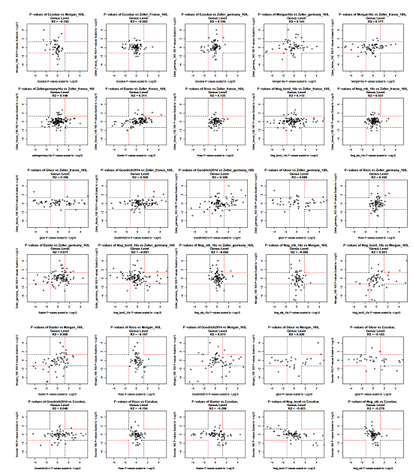

Pairwise Meta-analysis of associations with age shows little reproducibility
Anh Moss

Slide 35
Assertion:
The human and mouse guts represent profoundly
different ecosystems

Slide 36
What changes in a mouse transfer experiment?
Microbial Community from Feces to Slurry
Microbial Community from Slurry
to Mice
Healthy Control
n=4
n=1/donor
N=4
n=3-6/donor
N=21 slurries
n=1-3/slurry
n=12-14/donor
N=50 mice
Ian Carroll
UNC Chapel Hill
Anorexia before Treatment
n=4
n=1/donor
N=4
n=1-3/slurry
n=12-14 /donor
N=50 mice
n=5-7/donor
N=24 slurries
Anorexia after Treatment
n=4
Farnaz Fouladi
UNC Charlotte
n=1/donor
N=3
n=5-6/donor
N=23 slurries
n=1-4/slurry
n= 12-16 /donor
N=52 mice
Sequence variant analysis reveals poor correlations in microbial taxonomic abundance between humans and mice after gnotobiotic transfer. Fouladi et. al, ISME-J, 2020
Notes:
Fecal sample :1 sequencing of one donor from Anorexia after treatment failed (40T2)
In meta data we have 69 slurries……One slurry (HC 40) failed sequencing. 5 slurries of 40T2 was not included in fecal-slurry analysis because we don’t not have its fecal microbiota.
For a few number of mice we do not have the sequencing data of the slurries they receive so they are not included in the slurry-mice correlation analysis.

Slide 37
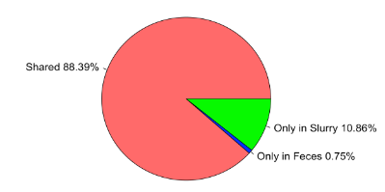
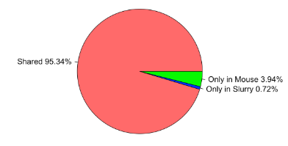
What changes in a mouse transfer experiment?
fecal to slurry
slurry to mouse
Shared 89%
Shared 95%
Ian Carroll
UNC Chapel Hill
Farnaz Fouladi
UNC Charlotte
Sequence variant analysis reveals poor correlations in microbial taxonomic abundance between humans and mice after gnotobiotic transfer. Fouladi et. al, ISME-J, 2020

Slide 38
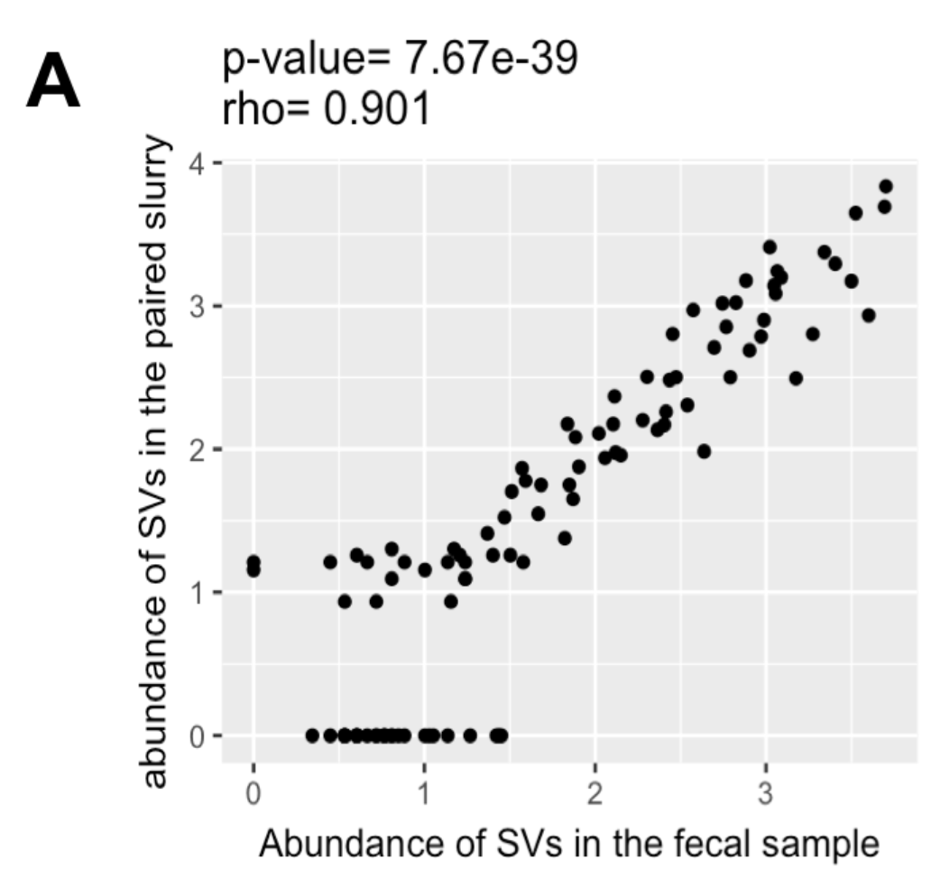
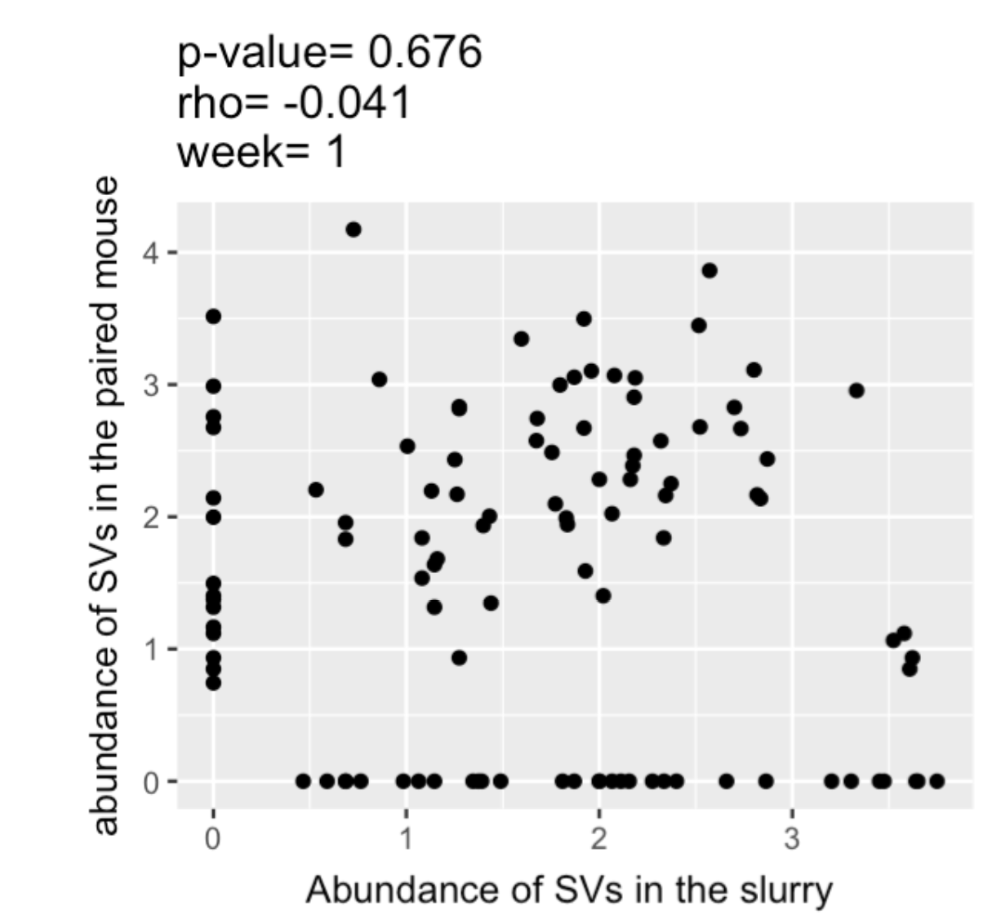
What changes in a mouse transfer experiment?
fecal to slurry
slurry to mouse
Shared 89%
Shared 95%
Ian Carroll
UNC Chapel Hill
Farnaz Fouladi
UNC Charlotte
Sequence variant analysis reveals poor correlations in microbial taxonomic abundance between humans and mice after gnotobiotic transfer. Fouladi et. al, ISME-J, 2020

Slide 39
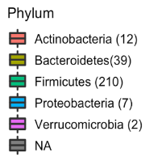
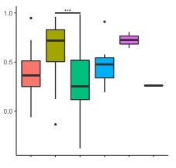
Transfer efficiency varies by different taxa
RHO
Ian Carroll
UNC Chapel Hill
Farnaz Fouladi
UNC Charlotte
Sequence variant analysis reveals poor correlations in microbial taxonomic abundance between humans and mice after gnotobiotic transfer. Fouladi et. al, ISME-J, 2020

Slide 40


Towards every analysis as a meta-analysis
Ivory Blakely–
UNC Charlotte
Michael Sioda
UNC Charlotte

Slide 41

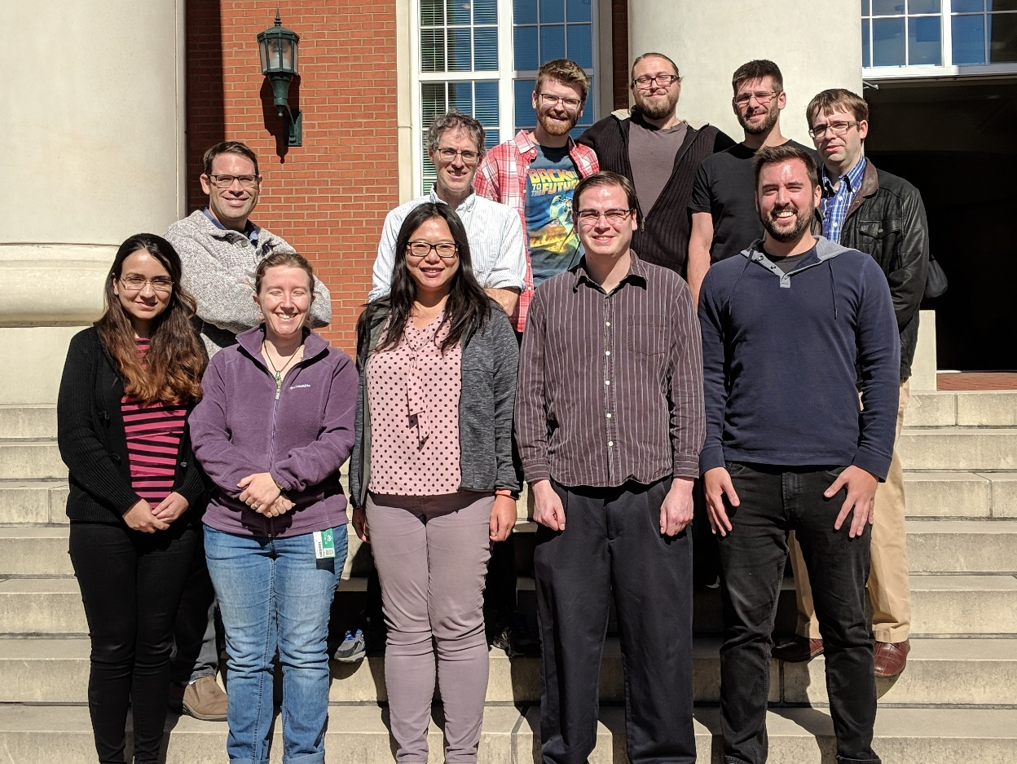

Slide 42
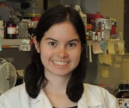




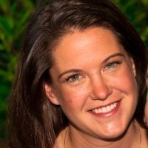






Acknowledgements
UNC-Chapel Hill
Janelle Arthur
Ian Carroll
Annie Green Howard
Marcus Muhlbauer
Penny Gordon-Larsen
Jonathan Hansen
Temitope Keku
UNC-Charlotte
Roshonda Barner
Matthew Brown
Farnaz Fouladi
Ra’ad Gharaibeh
Cynthia Gibas
Jon McCafferty
Shan Sun
Michael Sioda
Kathryn Winglee
Matthew Brown
UF- Gainesville
Christian Jobin
USC Vanderbilt University
Tanya L Alderete Martha J. Shrubsole
Michael Goran
Emily Noble
Scott Kanoski
Kathryn Winglee
Annie Green Howard
Penny Gordon-Larsen
Raad Gharaibeh
Jon McCafferty
Marcus Muhlbauer
Janelle Arthur
Christian Jobin

